Slide 1
Kirkham Town Council
Public Meeting
Morgan and Morecambe Wind Farms
16 November 2023

Slide 2
Introduction
Consultation Period Ends 23rd November
Notes:
Thank you for your attendance this evening
Introduction of speakers, Maggie Ledger, Tony Wellings and Mark Menzies MP
We are not opposed to the wind farms
There is a need for alternative power generation
We believe there are alternatives to the current proposals
Time scales, Consultation period ends 23rd November, so time is tight.

Slide 3
Morgan & Morecambe Wind Farm
Route
Onshore Substations Locations
Effects on the community
Other possible solutions
How to be involved in the consultation
Questions

Slide 4
Route
Notes:
Cables from the two wind farms at Morgan and |Morecambe to the National Grid in penwortham
Cables landing in the region of Blackpool Airport
From the Airport across the conservation area
Out across farmland and arriving in the area south of Lower lane
Crossin many roads and drainage ditches
120mtrs wide, wider than the M55
Some properties have been asked to provide mortgage details and house valuations, possible Compulsory Purchase of Homes
Ending up in Penwortham
Cost to farmers
Disruption to homes
Increased flooding

Slide 5
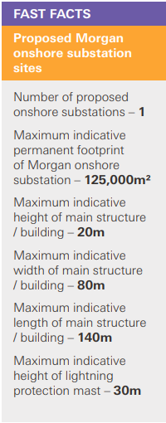
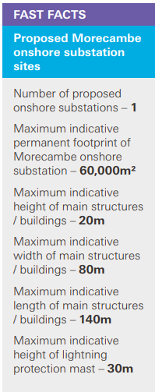
Onshore Substations Locations
Notes:
1. Close to Carr Hill and Strike Lane Schools
2. Covering an area equivalent to 18 football pitches Morgan
3. Covering an area equivalent to 9 football pitches Morecambe
3. Hight of 20mtrs 4 double decker buses with masts on top

Slide 6
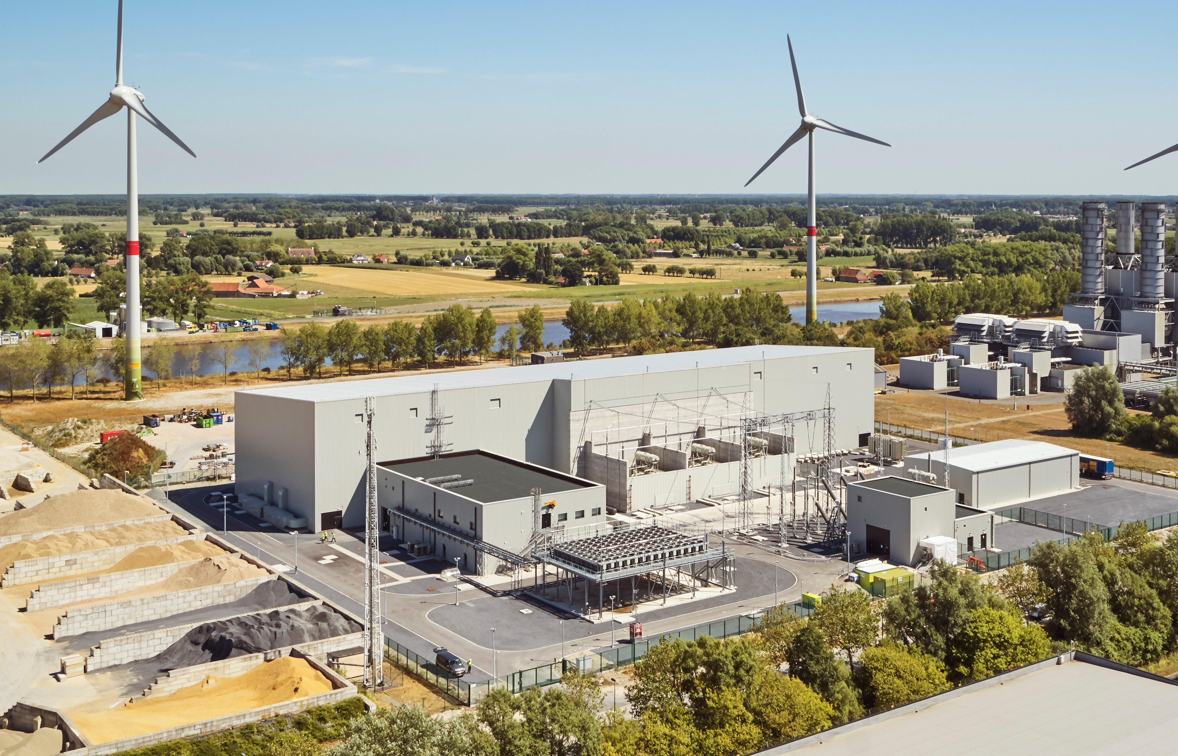
Notes:
1000 MW transformer building
3.1 GW in Kirkham

Slide 7
Effects on the Community
1. Will not create jobs
2. Increased Flood
3. Green belt land
4.Prime farmland
5. Close to Carr Hill and Strike Lane Schools
6. Area of separation
7. Noise level 38db above ambient (ambient is 30db) approaching 70db, Industry regulations state ear defence must be worn at levels above 80db
8. Increased traffic and disruption during construction
Notes:
1.. Will not create jobs – remotely monitored
2. Increased Flood risk Wet land
3. Green belt Land prime farmland
4. Area of separation Kirkham, Newton and Freckleton
4. Noise level 38db above ambient (ambient is 30db) approaching 70db, Industry regulations state ear defence must be warn at levels above 80db worse at night
5. Increased traffic during construction 6years

Slide 8
Other Possible Solutions
Using the Estuary
Heysham Power station
Notes:
Using the Estuary
Morgan & Morcombe have ruled this out due to environmental reasons, what about the effect on us?
There is already a Transformer at Penwortham, so it is possible to add another.
Taking the cables ashore at Heysham.
Heysham Power station is due to be decommissioned. Already has the infrastructure for the access to the National Grid
MP Mark Menzies is going to talk to National Grid to see if this is a possabillity

Slide 9
Summary
We agree with the offshore wind project.
Reconsider the Route, disruption to community, farmers, schools and traffic.
Onshore substation locations, Size, noise levels, potential flooding and environment.
Other Solutions

Slide 10
How to be involved in the consultation
Complete the On-line form
Complete a paper copy of the Online form
Email (Best Option)
info@morecambeandmorgan.com
Write a letter
FREEPOST MORECAMBE
AND MORGAN
Do not send as a household send separate submissions!
Notes:
The Morgan and Morcombe Form is long difficult to understand ref to other documents.
Same with the Online Form
Easiest option Email or write a letter
Including all the reasons why you object.

Slide 11
Any Questions?

